Slide 1
Humans Say the Darndest Things! But…
Is It Protected Speech or Unlawful Conduct?

Slide 2
In the News…
LBCC football coach apologizes for ‘dumb’ message he sent to prominent progressive journalist
The 11-year coach said the message has reflected poorly on the school but stood by his criticism of the “journalist’s integrity.” The college has not said how it will handle the situation.
by John Donegan
Long Beach Post News
Jan 20, 2025
Updated Jan 21, 2025

Slide 3
In the News…
Penn Professor's Fight for Free Speech Heads to Federal Court
Amy Wax is suing the Ivy League school for race discrimination, arguing that the university cracks down on speech unevenly depending on which group it offends
The complaint advances a novel legal theory that could have major implications for universities as they brace for the incoming Trump administration. Wax argues that Penn engaged in race discrimination by punishing speech that offended racial minorities but not speech that offended Jews, citing a litany of cases in which the school declined to discipline professors who deployed anti-Semitic tropes and called for the destruction of Israel.
by Aaron Sibarium
The Washington Free Beacon
Updated Jan 16, 2025

Slide 4
Objectives
Address distinction between lawful protected speech and speech that can be addressed as a violation of district policy and/or law.
Provide guidance on making thoughtful and diligent lawful determinations in compliance with legal rights and responsibilities.
Provide key questions to ask and answer when determining how to address speech-related cases or controversies.

Slide 5
Agenda
Preliminary comments on free speech litigation
Freedom of Speech principles, and types of speech that is not protected by the First Amendment
Speech by students
Speech by employees
Keys to addressing speech cases and controversies
Some case studies
(Additional) questions/answers

Slide 6
Free Speech Litigation in California
The Eleventh Amendment and its impact on district decision-makers
Qualified immunity
  Individuals are immune from liability if they believed that their conduct was lawful “in light of clearly established law and the information [that they] possessed.” Cohen v. San Bernardino Valley Coll., 92 F.3d 968, 973 (9th Cir.1996)

Slide 7
Speech Principles and Exceptions to Free Speech

Slide 8
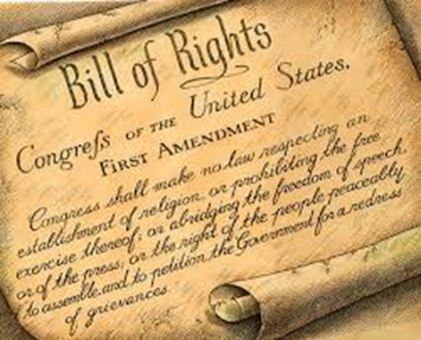
First Amendment
  “Congress shall make no law . . . abridging the freedom of speech, or of the press”
    (U.S. Constitution, 1st Amendment

Slide 9
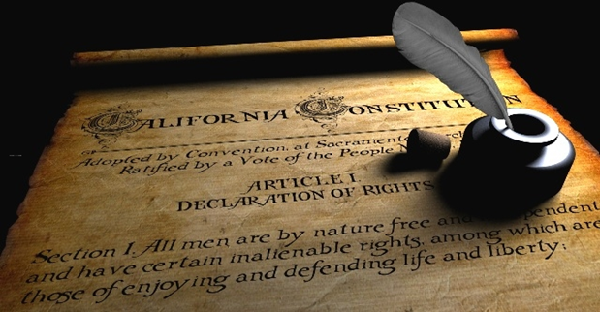
The California Constitution
  “Every person may freely speak, write and publish his or her sentiments on all subjects, being responsible for the abuse of this right. A law may not restrain or abridge liberty of speech or press.”
  Article I, Section 2(a), California Constitution

Slide 10
Whitney v. Ca. (1927), Brandeis, Concurring
“Those who won our independence by revolution were not cowards. They did not fear political change. They did not exalt order at the cost of liberty. To courageous, self-reliant men, with confidence in the power of free and fearless reasoning applied through the processes of popular government, no danger flowing from speech can be deemed clear and present unless the incidence of the evil apprehended is so imminent that it may befall before there is opportunity for full discussion. If there be time to expose through discussion the falsehood and fallacies, to avert the evil by the processes of education, the remedy to be applied is more speech, not enforced silence.”

Slide 11
Whitney v. Ca. (1927), Brandeis, Concurring
“[The Founding Fathers] recognized the risks to which all human institutions are subject. But they knew that order cannot be secured merely through fear of punishment for its infraction; that it is hazardous to discourage thought, hope and imagination; that fear breeds repression; that repression breeds hate; that hate menaces stable government; that the path of safety lies in the opportunity to discuss freely supposed grievances and proposed remedies; and that the fitting remedy for evil counsels is good ones.”

Slide 12
Unprotected Speech
Some forms of speech are not constitutionally protected:
True Threats: A statement intended to frighten or intimidate one or more persons into believing they will be seriously harmed by the speaker or by someone acting on behalf of the speaker.
Obscenity: a description or depiction of sexual conduct, taken as a whole by the average person, applying contemporary community standards, portrays sex in a patently offensive way, appeals to the prurient interest of the individuals and lacks serious literary, artistic, political, or scientific value.

Slide 13
Unprotected Speech
Some forms of speech are not constitutionally protected:
Incitement to Imminent Lawless Action: Speech that promotes imminent lawless action and is likely to incite or produce such action.
  A violent reaction of a crowd listening to a speech does not transform protected speech into incitement.
Defamation: Oral or written falsehoods (not merely a statement of the speaker’s opinion), communicated to a third party or parties, and would harm another person’s reputation:
  Oral communication = slander
  Written communication = libel

Slide 14
Unprotected Speech/Conduct*
Unlawful Harassment: Unwelcome conduct typically directed at someone specific, based on a legally protected characteristic that is subjectively and objectively offensive and is so severe or pervasive that it limits or denies a person’s ability to work or participate in the educational program.
  Racial insults or sexual advances directed at someone are considered non-expressive, as “they do not seek to disseminate a message to the general public but, rather, to intrude on the targeted individual.
  “Offensiveness of a particular expression as perceived by some students, standing alone, is not a legally sufficient basis to establish a hostile environment.” [OCR, May 7, 2024]

Slide 15
What about “Hate Speech”?
There is no “Hate Speech” exception to the First Amendment:
Things we call “hate speech” might occasionally fall into an existing First Amendment exception, such as:
  A racist speech might seek, through the words used and the commands given, to incite imminent violence against a group or property.
  A hateful political speech might, based on the actual words used, be reasonably interpreted as an immediate threat to do harm to individuals or a group.
But mean, nasty, angry, racist, sexist, homophobic expression, like other ugly types of speech we despise, is broadly protected.

Slide 16
“Hate Speech”
“Hate speech” is generally protected by the First Amendment, based on “the belief that freedom of speech requires the government to strictly protect robust debate on matters of public concern even when such debate devolves into distasteful, offensive, or hateful speech that causes others to feel grief, anger, or fear.”
(American Library Association, Hate Speech and Hate Crime (Dec. 12, 2017) at http://www.ala.org/advocacy/intfreedom/hate [as of Jan. 26, 2025].)

Slide 17
“Hate Speech”
The idea that the government may restrict speech that offends “strikes at the heart of the First Amendment. Speech that demeans on the basis of race, ethnicity, gender, religion, age, disability, or any other similar ground is hateful; but the proudest boast of our free speech jurisprudence is that we protect the freedom to express ‘the thought that we hate.’” (Matal v. Tam (2017) 137 S.Ct. 1744, 1764)

Slide 18
Protected “Hate Speech” vs. Harassment
Schools have a number of tools for responding to a hostile environment—including tools that do not restrict any rights protected by the First Amendment. To meet its obligation, a university can, among other steps, communicate its opposition to stereotypical, derogatory opinions; provide counseling and support for students affected by harassment; or take steps to establish a welcoming and respectful school campus, which could include making clear that the school values, and is determined to fully include in the campus community, students of all races, colors, and national origins.
(Office for Civil Rights (OCR), May, 2024)

Slide 19
ACLU “Hate Speech” Recommendations
Speak out loudly and clearly against expressions of racist, sexist, homophobic, and transphobic speech, as well as other instances of discrimination against marginalized individuals or groups;
React promptly and firmly to counter acts of discriminatory harassment, intimidation, or invasion of privacy;
Create forums and workshops to raise awareness and promote dialogue on issues of race, sex, sexual orientation, and gender identity;

Slide 20
ACLU “Hate Speech” Recommendations
Intensify efforts to ensure broad diversity among the student body, throughout the faculty, and within the college administration;
Vigilantly defend the equal rights of all speakers and all ideas to be heard and promote a climate of robust and uninhibited dialogue and debate open to all views, no matter how controversial.
(https://www.aclu.org/other/speech-campus?redirect=hate-speech-campus [as of Jan. 26, 2025].)

Slide 21
Assessing Expression on Campuses
The Foundation for Individual Rights and Expression (FIRE) assesses college campuses based on the following factors:
Openness
Tolerance for liberal speakers
Tolerance for conservative speakers
Administrative support for free speech
Level of comfort to express ideas
Disruptive conduct

Slide 22
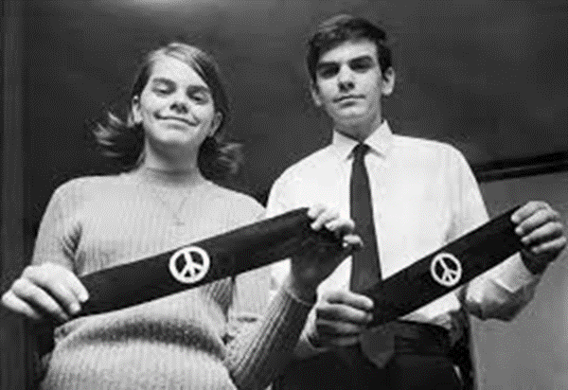
Is it Speech, or Conduct?
When words are not used:
Is there an intent to convey a particularized message?
If so, is the likelihood great that the message would be understood by those who viewed it?

Slide 23
Speech by Students

Slide 24
Student Speech – Education Code
Section 76034:
Students may not be disciplined for conduct unless “related to college activity or attendance”
Section 66301:
Students may not be disciplined solely on the basis of speech that would be protected outside a campus; exception for “harassment, threats or intimidation, unless constitutionally protected”

Slide 25
Student Speech – Education Code
Section 76120:
Board “shall adopt rules and regulations relating to the exercise of free expression by students upon the premises of each community college maintained by the district,” including “reasonable provisions for the time, place, and manner of conducting such activities.”
Rules and regulations shall not prohibit students’ exercise of free expression, unless expression is obscenity, defamation, or incitement creating “clear and present danger” of unlawful acts or “substantial disruption of the orderly operation of the community college.” (Tinker standard)

Slide 26
“Substantial Disruption”
  Evidence sufficiently forecasts “substantial disruption of or material interference with school activities” or shows an invasion of “the rights of other students to be secure and to be let alone”
  Actual disruption is not needed, but undifferentiated fear is not enough; need a well-founded expectation of disruption

Slide 27
Speech by Employees

Slide 28
What happens when…
A faculty member refuses to use the preferred pronouns of a student in their class?

Slide 29
Employee First Amendment Analysis
The Pickering Test:
Was the speech on matter of public concern, as opposed to a personal employment grievance?
If a matter of public concern, was the employee speaking as private citizen, and not pursuant to official duties?
If speaking as a citizen on a matter of public concern, was the speech was a substantial motivating factor in an adverse employment action against the employee?

Slide 30
Employee First Amendment Analysis
If the employee was speaking as a citizen on a matter of public concern, and the speech was a substantial motivating factor in an adverse employment action against the employee, the employment action is upheld if, under the circumstances, the employer’s interest in the efficient delivery of public services performed through its employees outweighs the employee’s interest in speech.
Balancing test, and a case-by-case analysis.

Slide 31
What About Academic Freedom?
Pickering test applies to public university professor’s speech related to scholarship or teaching. Demers v. Austin (9th Cir., 2014) 746 F.3d 402 -- The employee’s speech is protected when it is on a matter of public concern, and when the employee's interest “in commenting upon matters of public concern” outweighs “the interest of the State, as an employer, in promoting the efficiency of the public services it performs through its employees.”
In other words, a teacher or professor’s speech related to scholarship or teaching is never deemed not pursuant to official duties.

Slide 32
Some
Case Studies

Slide 33
Rodriguez v. Maricopa County CCD (2009)
“We consider the interplay between the First Amendment and the right to be free of workplace harassment on the basis of protected status.”
Math professor sent three racially-charged emails over a distribution email list maintained by the district, received by every district employee.

Slide 34
Rodriguez v. Maricopa County CCD (2009)
In the emails:
“Why is the district endorsing an explicitly racist event?” (Dia de la Raza.)
“YES! Today's Columbus Day! It's time to acknowledge and celebrate the superiority of Western Civilization.”
“Native Americans actually committed genocide against the original white-skinned inhabitants of North America.”
“America did not become the mightiest nation on earth without distinct values and discrimination” and asserted that “[o]ur survival depends on discrimination.”
“The only immigration reform imperative is preservation of White majority.”

Slide 35
Rodriguez v. Maricopa County CCD (2009)
No disciplinary action was taken against the professor.
No steps were taken to enforce the district’s anti-harassment policy.
A group of Hispanic employees filed a lawsuit, seeking monetary damages on the ground that the district “failed to take immediate or appropriate steps” to prevent harassing emails.

Slide 36
Rodriguez v. Maricopa County CCD (2009)
The lawsuit was dismissed by the appellate court.
Why do you think this occurred?
What steps might the district have taken that absolved the district of liability, or even going to trial?
If the district had disciplined the professor, would the district have been more exposed to liability?

Slide 37
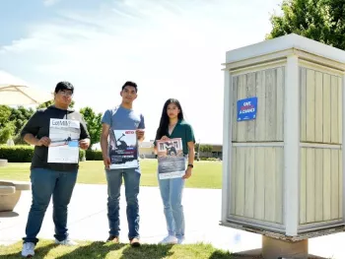
Flores v. Bennett
District set general guidelines that outlined the places on campus where students may post flyers and distribute printed materials.
A student submitted three Freedom Week Flyers to the College's Student Center Staff for approval, they were approved and posted on the bulletin boards in the Academic Center.

Slide 38
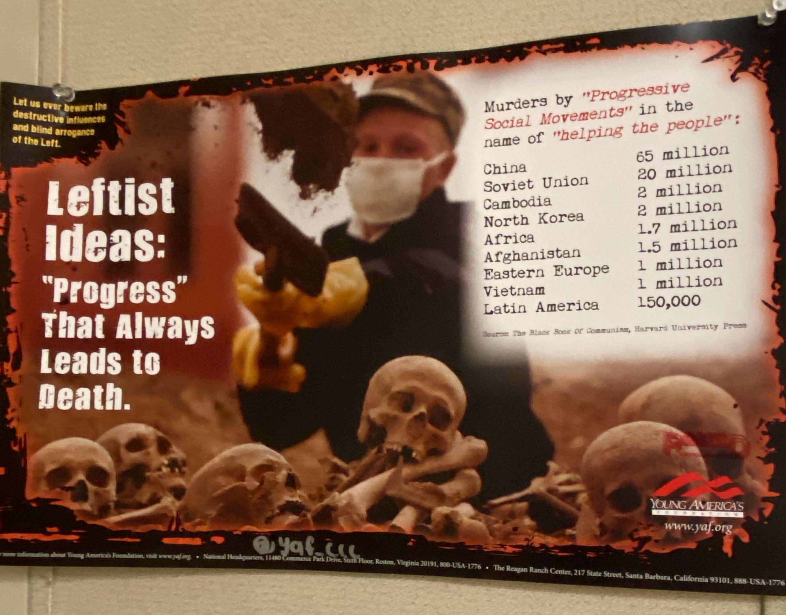

Slide 39


Slide 40
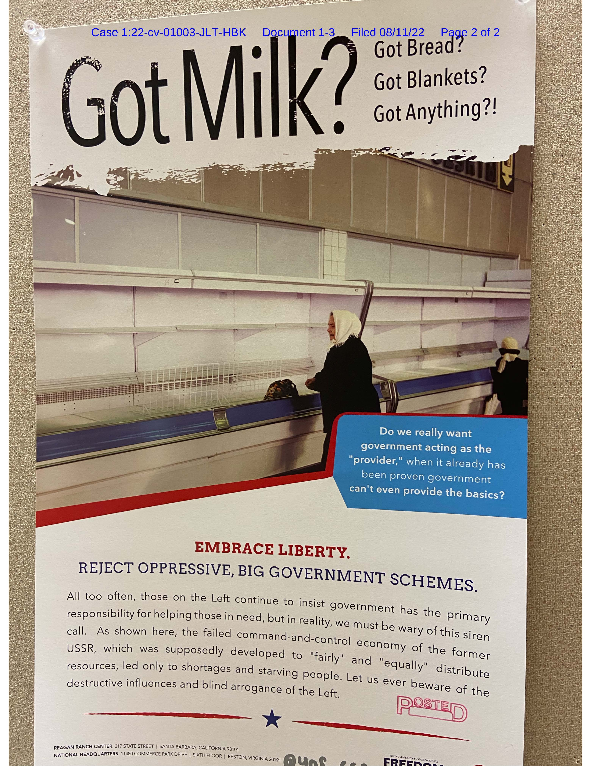

Slide 41
Flores v. Bennett
After several days on the bulletin boards, the Student Center Staff began receiving complaints that the flyers made people feel “uncomfortable.”
The college officials decided to permit the Freedom Week Flyers to remain on the bulletin boards until the end of Freedom Week and then had them removed, because “[the flyers] aren't club announcements.”

Slide 42
Flores v. Bennett
“Clear and present danger” of unlawful acts or “substantial disruption of the orderly operation of the community college.”
“Reasonable provisions for the time, place, and manner of conducting such activities?”
True Threats?
Obscenity?
Incitement to Imminent Lawless Action?
Defamation?
Harassment?

Slide 43
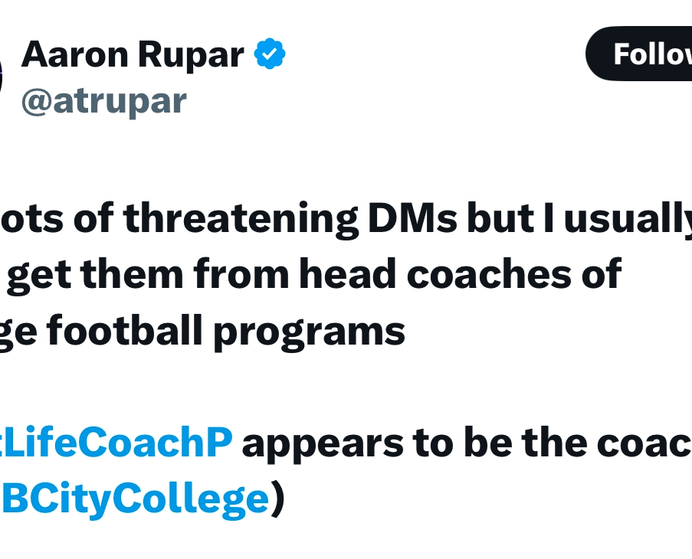
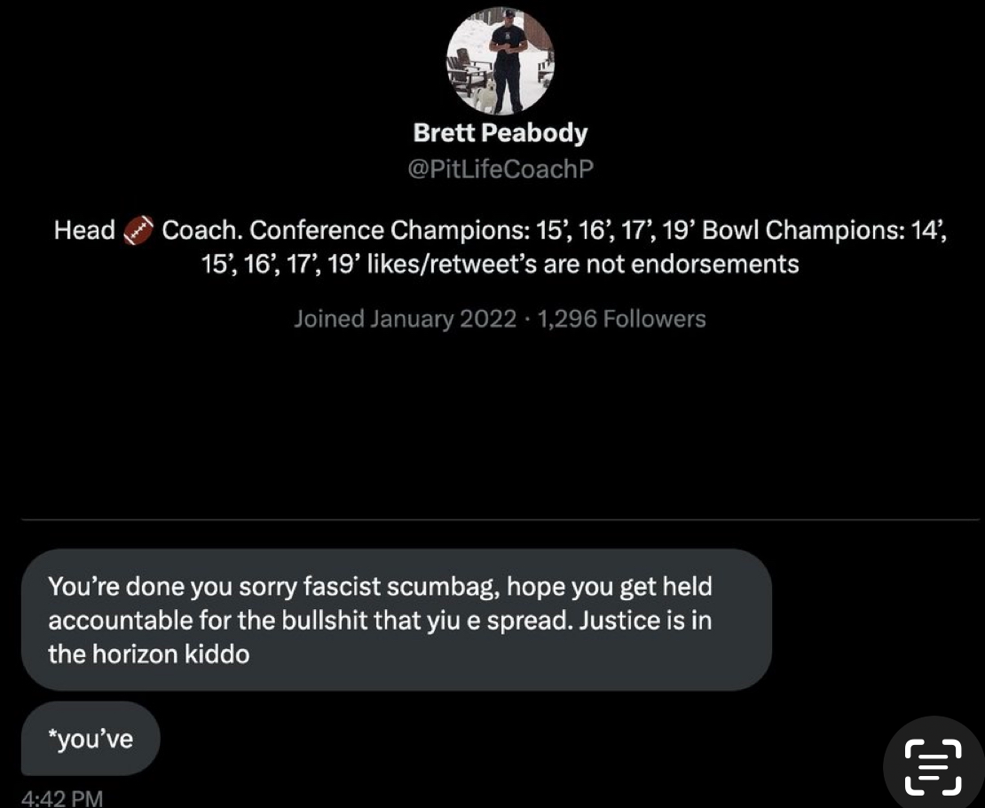

Slide 44
Questions/Answers

Slide 45
Thank You!

