Slide 1
Risk Happens: Contract Smarter, Not Harder

Slide 2
Expert Panel:
Nicole Fayaz,
Director of Account Management
Meredith Brown, Partner
Randall Parent, Of Counsel
Jamie Ruggles, Associate Vice Chancellor, Finance
Kaitlyn Sherer, Executive Assistant, General Counsel

Slide 3
What Will Be Discussed
Before entering into an agreement
Analyzing the risk
Insurance requirements
Contract Basics and Key Terms
Indemnification
Sample Contract Language
Recognizing Red Flags in Contracts
Real Life Examples
A Team Effort: When to Involve Risk and Legal

Slide 4
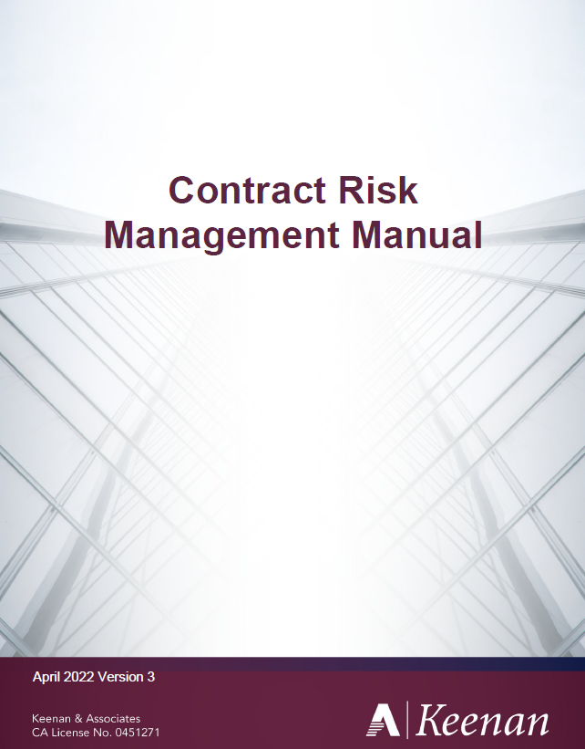
Keenan Contract and Risk Management Manual

Slide 5
Review and Approval Process
1
2
3
Initial Review
Risk Assessment
Negotiation & Approval
Procurement staff evaluates the contract's insurance requirements, comparing them to existing district policies.
The district risk management department assesses the potential risks associated with the contract and the proposed insurance coverage.
Negotiations with the vendor may be necessary to modify insurance coverage to meet district requirements. Final approval comes from the district’s legal counsel, risk management, or designee.
Notes:
What most looks like but would love in an ideal world to have the risk assessment come first.
Step

Slide 6
What sort of events/activities do you have on your campus?
What are some of the reasons these events are happening?
Notes:
. This is a decision that must be made at the District
. What are some reasons for having these events?
- You want to have events/activities that are going to push curriculum
- You want your event to be fun
- You want to help your community
. Although these are all great reasons to have an event or activity on your campus. It is important to think about the risks or bad things that could arise out of the activity or event. Ultimately, the District is held liable for these events that take place on the campus.

Slide 7
When is an activity too risky?
Notes:
NF
. This is a decision that must be made at the District
What is the educational benefit?
. What are some reasons for having these events?
- You want to have events/activities that are going to push curriculum
- You want your event to be fun
- You want to help your community
. Although these are all great reasons to have an event or activity on your campus. It is important to think about the risks or bad things that could arise out of the activity or event. Ultimately, the District is held liable for these events that take place on the campus.

Slide 8
Contract Manual pages 5-11
Notes:
NF
. This is a decision that must be made at the District
What is the educational benefit?
. What are some reasons for having these events?
- You want to have events/activities that are going to push curriculum
- You want your event to be fun
- You want to help your community
. Although these are all great reasons to have an event or activity on your campus. It is important to think about the risks or bad things that could arise out of the activity or event. Ultimately, the District is held liable for these events that take place on the campus.

Slide 9
Who…
…might be affected or injured
Students
Minors? Adults?
Employees
Volunteers
Visitors
Bystanders Participants
Public
Neighbors

Slide 10
What…
…is at risk
Property
Intellectual Property/PII
Reputation
Notes:
School and personal property.
Data, information.
“What would this look like in a headline..”

Slide 11
Where
On Campus
Waivers
Travel advisories
Weather
High risk location
Notes:
Some placed pose a bigger risk than others. Swimming pools (or any body of water) is the biggest red flag from our standpoint. Extremely high risk,, very important to consider whether the reward outweighs the risk here. If the activity is off-site, are you able to inspect it for hazards before use?

Slide 12
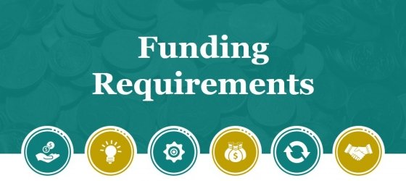
Why
Notes:
Full circle back to balancing the risk…why is this event or contract necessary and does it outweight the benefits.
What is the educational benefit?
The only way to prevent a risk all together is to not do anything. Since that is an impossibility, it is important to do a risk assessment to weigh the costs and benefits of the task at hand.
Nothing wrong with fun, it just doesn’t carry as much weight on the risk vs reward scale and the headlines will be harder to defend.

Slide 13
Insurance Requirements
Notes:
Now its time to put pen to paper. We have some amazing contributors here who are going to dive deeper into hold harmless, indemnification, negotiating strategies but I just want to finish my piece with tying the insurance requirements to the contract.

Slide 14
Insurance should cover exposures arising out of services
Develop a checklist system based on contract
Confirm insurance requirements have been met
Create a follow up system
Notes:
Really if we go through the excersize we just did, it sort of points us in the right direction of what insurance to ask for. If you’re making sure all the scenarios are outlined in the contract and especially the scope of work, we can identify what type of insurance is now needed.

Slide 15
Standard Insurance Requirements
General Liability
Workers' Compensation
Provides coverage for potential damages caused to third parties by the contractor or its employees during project execution.
Covers medical expenses and lost wages for employees injured while performing their duties.
Per the Department of Industrial Relations:
All California employers must provide workers’ compensation benefits to their employees under California Labor Code Section 2700. If a business employs one or more employees, then it must satisfy the requirement of the law.
Side
Note
Contract Manual pages 18-22

Slide 16
Additional Insurance Considerations
Professional Liability
Provides coverage for claims alleging errors, omissions, or negligence in the performance of professional services by the vendor.
Commercial Auto Liability
Protects against claims arising from accidents involving vehicles used for business purposes, ensuring coverage for liability and damage.
Cyber Liability
Provides coverage for claims caused by cyber incidents such as data breaches, ransomware attacks, viruses, hacking, etc.
Sexual Abuse Molesation
Protects against claims arising from allegations of abuse or misconduct

Slide 17
Additional Insured Endorsements
Purpose
Types
Endorsements extend coverage/protection to the district in case of liability arising from the vendor's activities.
Endorsements can be either "blanket" or "named,"
Importance
Ensuring the appropriate type of endorsement is crucial for protecting the district’s financial interests and mitigating potential risks.

Slide 18
Statewide Association of Community Colleges
Annual Conference 2025
Contractual Liability and Indemnification Understanding
Key Contract Terms
PRESENTED BY: Meredith Brown, Partner
Randall Parent, Of Counsel

Slide 19
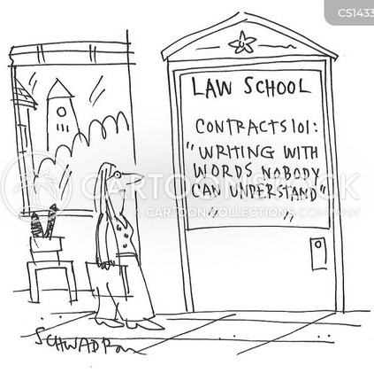
Demystifying Contracts
Agenda
Contract Basics
Key Terms
What Can Go Wrong?
INTERMISSION
Checklist for Contract Reviews
Examples of Template Language

Slide 20
The Procurement Method Matters
Competitive Bidding
Request for Proposals
“Piggyback” Contracting

Slide 21
Competitive Bidding
Public Contract Code section 20651(a) requires the governing board of any community college district to competitively bid and award contracts involving an expenditure of more than $50,000 for any of the following:
1. The purchase of equipment, materials, or supplies to be furnished, sold, or leased to the district.
2. Services that are non-construction; and,
3. Repairs, including maintenance as defined in PCC section 20656, that are not public projects as defined in PCC section 22002(c).
The Board of Governors of the California Community Colleges, pursuant to PCC section 20651(d) shall annually adjust the $50,000 amount specified in section 20651(a) to reflect the percentage change in the annual average value of the Implicit Price Deflator for the prior fiscal year rounded to the nearest one hundred dollars ($100). The Board of Governors has delegated this responsibility (through standing orders) to the Chancellor.
The applicable adjustment of .259% applied to the current bid threshold of $114,500 results in the new threshold of $114,800 (rounded to the nearest one hundred). This new bid threshold shall commence with the 2024 calendar year.
(California Community Colleges Memorandum dated December 9, 2024, from Director of Facilities Planning and Utilization, College Finance and Facilities Planning Director to Chief Business Offices, Facilities Directors).

Slide 22
Request for Proposals
Pursuant to Education Code § 81645, the governing board of any community college district may contract with a party who has submitted one of the three lowest responsible competitive proposals or competitive bids for the acquisition, procurement, or maintenance of electronic data processing systems and equipment, electronic telecommunications equipment, supporting software, and related materials, goods, and services, in accordance with procedures and criteria established by the governing board.
The procedures and criteria for evaluation should be clear and concise and should be approved/adopted by the governing board prior to issuance of the RFP.

Slide 23
“Piggyback” Contracts
What is “Piggybacking” contracting?
An exception to the bidding requirement that allows a public agency to procure materials, supplies, or equipment by “piggybacking” on another public entity’s competitive procurement and contract.
(California Public Contract Code § 20652)

Slide 24
Example - Piggyback Contracting through Foundation for California Community Colleges
Education Code sections 72670, Public Contract Code sections 20652 and 20661, and California Code of Regulations, Title V, Sections 59130-59132 provide the statutory authority for the Foundation CCC to enter into voluntary purchasing agreements on behalf of the California Community Colleges Chancellor’s Office and the California Community.
California Community Colleges may use Foundation CCC agreements without having to conduct their own bidding processes.

Slide 25
Board Approval Required for All Contracts
All Contracts Must Be Approved or Ratified By Board
Including “Fundamental Changes to Contracts”
Benefit: Vendor Responsible for Knowing Board Approval
“This Contract Is Not Valid or Binding on District”
Danger: Other Vendors Challenge Validity
“District Illegally Entered into Contract”

Slide 26
Key Contract Components to Check For
Business License
Scope of Work
Deliverables
Term of Performance
Compensation
Indemnification
Insurance
Dispute Resolution/Default Procedures and Remedies
Termination

Slide 27
Contract Terms and Their Meanings
Business License - A person or entity doing business within a county must have a business license issued by the county, or an incorporated city within the county. A person who conducts business within an incorporated city within the county must have a business license from that city unless they are otherwise exempt.
Why do we care whether the vendor has a business license? There is a rebuttable presumption that an individual is an employee unless specific criteria are met that establish an independent contractor relationship between the service provider and the hiring entity. The IRS may impose taxes and penalties for misclassification of employee as independent contractor. A business license is one of several criteria to classify an individual as an independent contactor. Consult your HR Department.
Independent Contractor Status – Pursuant to California Labor Code section 2776, the determination of whether the individual is an employee or independent contractor is met if the hiring entity, which in this case would be the District, demonstrates that specific factors enumerated in the statute are satisfied.

Slide 28
Contact Terms and Their Meanings - continued
Scope of Work – Detailed description of the services that the District desires to receive from the vendor.
Deliverables – Detailed description of the materials, work product, or tangible items that the District desires to receive from the vendor.
Term of Performance – The timeline to perform the services that the District desires to receive from the vendor. Note: Make sure to set milestones or benchmarks that must be met by the vendor to demonstrate progress. The vendor’s achievement of progress benchmarks should be a precondition of payment on the contract.
Compensation – What is the amount to be paid under the contract?
Not to exceed amount – The contract price should include all costs, expenses, taxes and insurance.

Slide 29
Compensation
Main Focuses…
Definitive Amount
“Not to Exceed”, “Total Payment for All Services”, etc.
Reimbursable Defined
What constitutes a reimbursable; total payment limit
Additional Costs Subject to Approval
Prior written approval required; Board Approval

Slide 30
Indemnification – Avoid indemnifying Vendors
Note: The District should avoid indemnifying vendors because vendors carry insurance to insulate themselves against risk as a cost of doing business, which is built into the contract as overhead. However, most vendor contractors include indemnification language.
Vendor’s Contract says:
“You agree to hold harmless, indemnify and, at Vendor’s request, defend Vendor, its affiliates and their respective officers, directors, agents and employees (collectively, “Vendor Parties”) from and against any and all claims (including liabilities, damages, losses, costs and expenses and reasonable attorneys' fees) arising from this Agreement except to the extent caused by Vendor’s gross negligence or willful misconduct.”

Slide 31
Limitations on Liability
Vendor’s Contract says:
“Under no circumstances shall Vendor be liable to any person for any loss of profits, loss of use of equipment, loss or corruption of data or indirect, incidental, special, exemplary or consequential damages, or for any payment related to or as a result of such losses or damages arising out of or otherwise related to this Agreement. Vendor’s cumulative liability to the other party or to any person shall in no event exceed an amount equal to the total payment received by Vendor for the prior two months of services provided under this Agreement.”

Slide 32
Insurance
General liability covers a lot of common issues that you might run into, particularly if you work on client properties or interact with customers on a day-to-day basis. Basically, this essential insurance policy covers bodily damage, property damage, and even reputational damage that were caused by your business.
Worker’s Compensation Insurance – California law requires that employers, including those in the construction industry, carry workers' compensation insurance, even if they have only one employee. The insurance exists for employees who get hurt or sick because of work.

Slide 33
Insurance
Main Focuses…
Risk Management Team Review
Requirements Depend on Project and District Coverage
District Named As Additional Insured
District is Protected
No Indemnity Limit
Vendor Must Honor Indemnification Requirement Even if Cost Above Insurance Coverage

Slide 34
7. Termination Rights
1) Termination For Cause
If Vendor Breaches The Contract
If Vendor Provides Substandard Services
District Can Terminate Agreement And Deduct ALL Costs Associated With Termination
2) Termination For Convenience
District Can Terminate At Any Time Without Cause
Include “Termination Fee” Such As 10% Of Remaining Contract
Avoid Granting Vendor Right To Terminate For Convenience
3) The contract should expressly state that the District’s contract remedies shall survive termination of the contract.

Slide 35
14. Governing Law and Venue
What is “venue”?
It is the geographical location, i.e. city, county and state which may exercise jurisdiction over the parties and their dispute, and is where a lawsuit may be brought. Jurisdiction means the Court which may decide a parties’ dispute, and render a judgment or decision which is legally binding and enforceable on them.
Note – Require that the venue for the contract be in California, in the county where your community college district is located to avoid potential exposure to unfavorable interpretation of your contract by a foreign state, and legal fees to litigate in a different state.

Slide 36
Important Details – Vendor Employee Management
Note: Avoid potential liability for the Vendor’s workforce management. Require the following contract terms be included in the agreement :
Vendor Is Responsible for Paying All Wages
Vendor Employees Are Not Employees of the District
Employees Must Comply with District Safety Procedures
Background Checks If Necessary
District Has Right to Demand Removal and Replacement of Any Employee for Any Reason

Slide 37
The Checklist
Procurement Method
Approved by Board
Describe Services
Term / Timeline
Indemnity Provisions
Limitation on Liability
Termination Rights
Insurance Obligations
Employment Management
Warranties
Fees
Associated Documents
Data Management
Governing Law
Final Review

Slide 38
District Contract Language to Attached to Vendor Proposal – Streamlined Samples
1. Entire Contract: This CONTRACT, when accepted by the Vendor either in writing or other commencement of performance hereunder, contains the entire CONTRACT between the parties with respect to the matters herein, and there are no restrictions, promises, warranties or undertakings other than those set forth herein or referred to herein. The term Vendor includes contractors and consultants; the term “District” refers to ___________College District.
Except as otherwise provided in subsection 2.1 below, the entire CONTRACT consists of a) District’s solicitation/request for bids or proposals, together with plans and specifications, if any, b) Vendors bid or proposal, if any, c) the Purchase Order, and d) these terms and conditions. Except for any section or subsection marked “WAIVED”, each provision of the terms and conditions applies to the CONTRACT.
2. Amendments: This CONTRACT may be modified or amended upon mutual agreement, in writing, between District and Vendor.
2.1 Any other terms, conditions, or limitations suggested by Vendor shall not form a part of this CONTRACT, unless accepted in writing by District. In no event, shall an e-mail, voice-mail or electronic communication of any type be construed as a writing for purposes of obligating the District.
3. Governing Law and Venue and Attorney Fees: This CONTRACT has been negotiated and executed in the State of California and shall be governed by and construed under the laws of the State of California, including, but not limited to, the Public Contract Code, Education Code, Government Code, and Labor Code. Any action or proceeding for dispute resolution arising out of this CONTRACT shall be brought and tried in the County of ________, State of California, and the prevailing party shall be entitled to reasonable attorney fees.

Slide 39
Performance: Vendor shall perform services in accordance with the schedule in CONTRACT with the number of days meaning calendar days, unless otherwise stated. No partial performance shall be accepted.
5. Acceptance/Payment: Unless otherwise agreed to in writing by District, acceptance shall not be deemed complete unless in writing and until all the goods or services have actually been received, inspected, and tested to the satisfaction of District, and payment shall be made in arrears after satisfactory acceptance. District reserves the right to reject any good or service which does not comply with the specifications and/or terms of this CONTRACT.
6. Payment Terms:
6.1 Standard: Net 30 days unless otherwise stated in CONTRACT.
6.2 Invoices: Vendor shall submit itemized invoices to District, as shown below:
______________ Community College District
Attn.: Associate Superintendent/Vice President of Finance and Administration
Address
6.3 Each invoice must show District’s Purchase Order number, item number description of supplies or services, sizes, units of measure, quantity, unit price and extended totals, and shall cover only goods delivered or services performed. Invoices shall include supporting documentation including but not limited to, paid receipts and invoices to validate the charges for each invoiced item. Incomplete invoices shall be returned to the Vendor.

Slide 40
11. Termination: In addition to any other remedies or rights it may have by law, District may in its sole and absolute discretion, terminate this CONTRACT without penalty immediately with cause or after 30 days’ written notice without cause, unless otherwise specified. In such cases, Vendor shall be entitled to payment only for goods, materials or services performed that District has accepted.
13. Performance: Vendor shall perform all work under this CONTRACT, taking necessary steps and precautions to perform the work to District’s satisfaction. Services performed are subject to, and must conform to District’s Standard Specifications, (unless otherwise specified), which are incorporated herein by this reference and made a part hereof. Vendor shall be responsible for the professional quality, technical assurance, timely completion and coordination of all documentation and other goods/services furnished by the Vendor under this CONTRACT. Vendor shall perform all work diligently, carefully, and in a good and workman-like manner; shall furnish all labor, supervision, machinery, equipment, materials, and supplies necessary therefore. Vendor shall be fully responsible for all work performed by subcontractors and shall not utilize unlicensed or uninsured subcontractors.

Slide 41
15. Compliance with Laws: Vendor represents and warrants that services to be provided under this CONTRACT shall fully comply, at Vendor’s expense, with all standards, laws, statutes, restrictions, ordinances, requirements, and regulations (collectively “laws”) applicable to the services at the time services are provided to and accepted by District.
16. Pricing: The CONTRACT bid price shall include full compensation for providing all required goods, in accordance with required specifications, or services, as specified herein or when applicable, in the scope of services attached to this CONTRACT, and no additional compensation will be allowed therefore, unless otherwise provided for in this CONTRACT.
17. Indemnification and Insurance: To the fullest extent permitted by law, Vendor shall defend, indemnify and hold harmless the District, its directors, officers, engineers, employees, or agents against any and all claims, damages, losses and expenses, including reasonable attorney’s fees and costs to defend arising out of the performance of the work, and caused in whole or in part by any negligent or omission of Vendor or any subcontractor or anyone directly or indirectly employed by any of them, or anyone whose acts any of them may be liable, except where caused by the active negligence, sole negligence, or willful misconduct of the District, its directors, officers, engineers, employees, or agents.

Slide 42
Final Thoughts – Don’t Hesitate to Question the Vendor’s Contract Terms
What does this provision mean?
Does it favor the vendor or the District, or is it neutral?
How does this provision affect other provisions in the contract?
How can this provision be revised?
Is this provision a “deal breaker?”

Slide 43
Recognizing Red Flags in Contracts
High-Dollar Contracts with Unclear Terms
Vague or missing deliverables
Ambiguous scope or payment conditions
Example: “Access college’s current practices”
Which practices are being accessed, and how?
Remember: If deliverables or terms are not clear, enforceability is at risk.
Third-Party Representation
A party making promises on behalf of another entity without proper authority
Inaccurate Company Information
A company name spelled incorrectly within its own contract

Slide 44
Recognizing Red Flags in Contracts
Personal Liability Concerns
College’s authorized signer is held liable in a personal capacity
Contracts with Littered with Excessive Acronyms and Jargon
Frequently encountered in IT contracts
Can cause confusion and ambiguity, jeopardizing enforceability
Hyper-Technical, Legalistic Approach
Vendor or contractors requesting extensive legalistic edits may exhibit litigious or argumentative tendencies.
Such requests can also suggest past disputes or litigation with previous clients

Slide 45
Other Important Things to Keep in Mind
Contract Modifications
All changes, whether handwritten, redlined, or added on a separate document,
must be initialed by every party.
Execution Requirements
The contract must be fully executed before any work commences
Starting work without a signed contract exposes the college to liability.
Negotiating leverage on unfavorable terms is significantly reduced if work has already begun.

Slide 46
Real Examples
A third-party made promises on behalf of another
No legal terms and conditions
Details on deliverable are missing
Company’s name is spelt wrong
Annual payments are not clearly listed.

Slide 47
Real Examples
When asked to sign the college’s standard contract, a contractor demanded the removal of the insurance and indemnification clauses.
They then provided an alternate agreement and requested the college sign it instead.
After negotiations proved unsuccessful, the college contracted with a different vendor.

Slide 48
Real Examples
An architect requested 8 pages of revisions to colleges template agreement.
These changes were highly technical and numerous.
After the college declined these revisions, the architect submitted a much shorter list of edits.
The college was then able to reject the most problematic requests and find a middle ground on the others.

Slide 49
Practical Tools – Routing Sheet
gs-113 - template.docx
This document is required for every agreement signed by the district.
It requires a multi-person review of each contract to ensure glaring errors are addressed before moving further up the ladder.

Slide 50
Practical Tools – Contract Checklist
CONTRACT REVIEW CHECKLIST.docx
This is an example of what a contract checklist could look like to ensure a comprehensive review of the more common, and essential, provisions.

Slide 51
When To Involve Risk Management
Unusual or Inherently Hazardous Activities
Examples include leapfrog aerial displays or events with bounce houses
Risk reviews the District’s liability exposure and may recommend denying the request or introducing additional precautions (e.g., higher insurance limits or a security plan)
Non-Standard Insurance Requirements
When unusual coverage is necessary (e.g., fine art insurance)
When changes to standard insurance limits are requested

Slide 52
When To Involve the Legal Team
Non-Standard Contracts:
If the college’s approved templates are not being used.
Significant changes to college’s templates are requested.
Key Terms or Clauses
Look for markers such as indemnification, liability, or release of liability.
Uncertainty
If there’s any doubt, it’s always best to consult the legal team as early as possible!

Slide 54
Thank You!

